Slide 1


Project Guide Dr. K.Kumar M.E., Ph.D., Associate Professor
ONLINE EXAM MONITORING SYSTEM
Panel Members
Dr.R.Bhavani M.E., Ph.D
Assistant Professor
Prof . C.Gayathri M.E.,
Assistant Professor
TEAM -12
Divya A(1817116)
Hafeeza Begum M (1817118)
Keerthana K(1817123)
Pavithra T(1817137)

Slide 2


Verification Process
Monitoring Process
Face Detection
Eye Tracking
Person counting
Face Recognition
Mobile phone detection

Slide 3
Work Flow of Eye Tracking
Input frame
RGB to Grey Scale Conversion
Eye Detection
Eye Edge Detection
Found ?
NO
YES
Draw Eye Region
Save Eye Central Point

Slide 4
Work Flow of Object Detection
Input frame
Bounding Box
Objectness Score >0.5 ?
NO
Ignore the Bounding Boxes
YES
Apply Non Maximum supression
Output image with object detection
Identify the class confidence

Slide 5
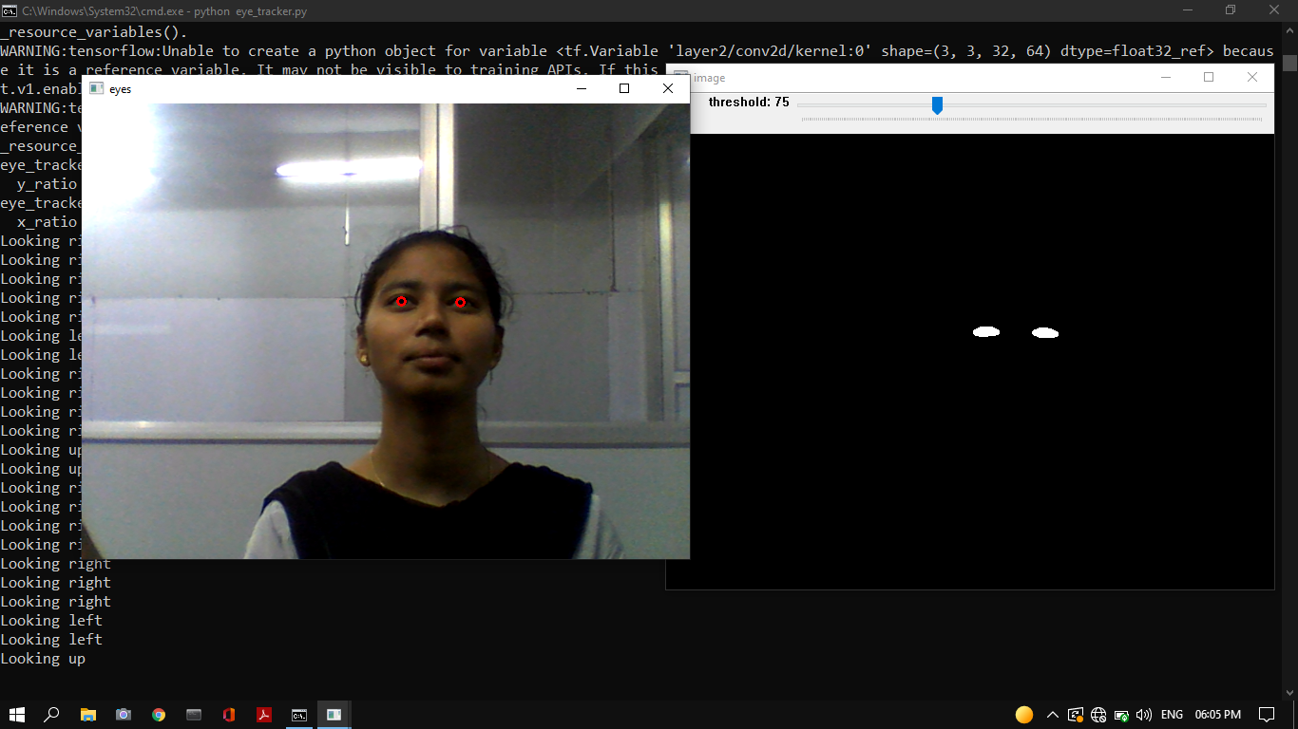
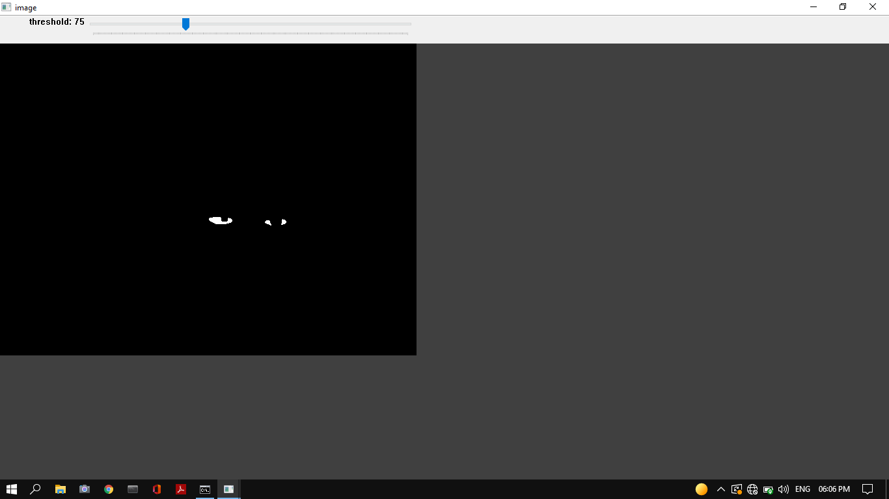
Output For Eye tracking
Binary Masking of eyeballs
Looking up Detected

Slide 6
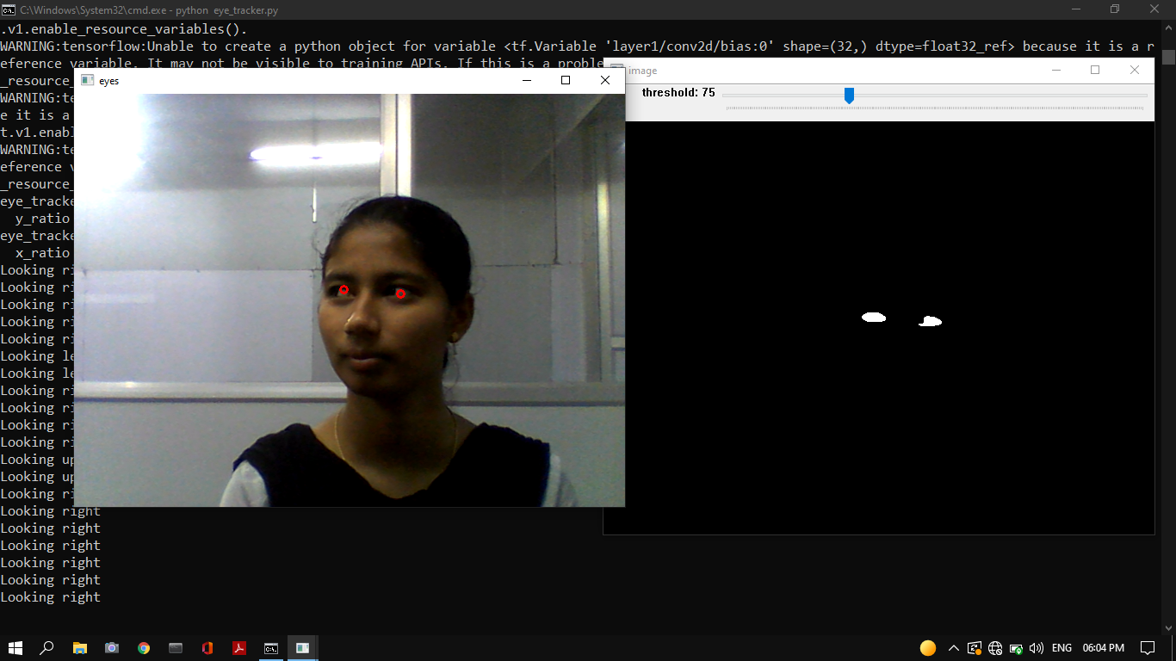
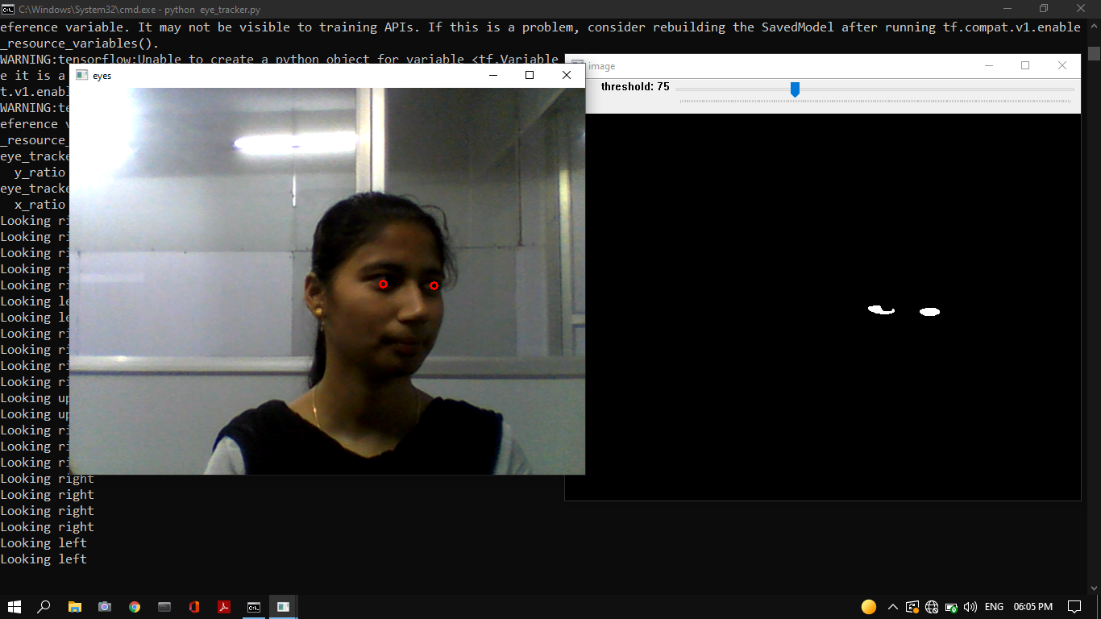
Output For Eye tracking
Looking Right Detected
Looking Left Detected

Slide 7
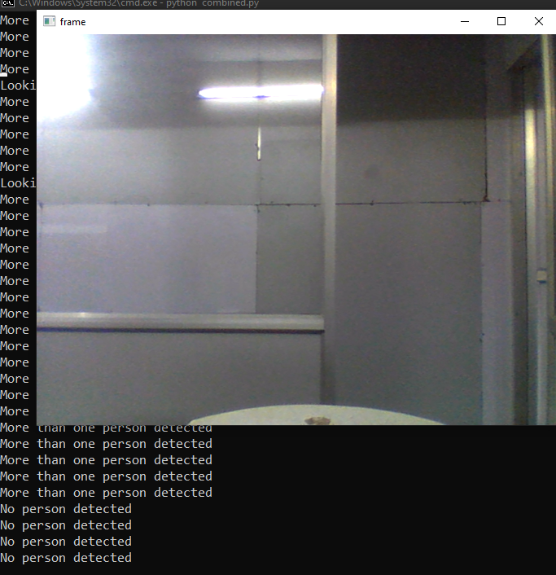
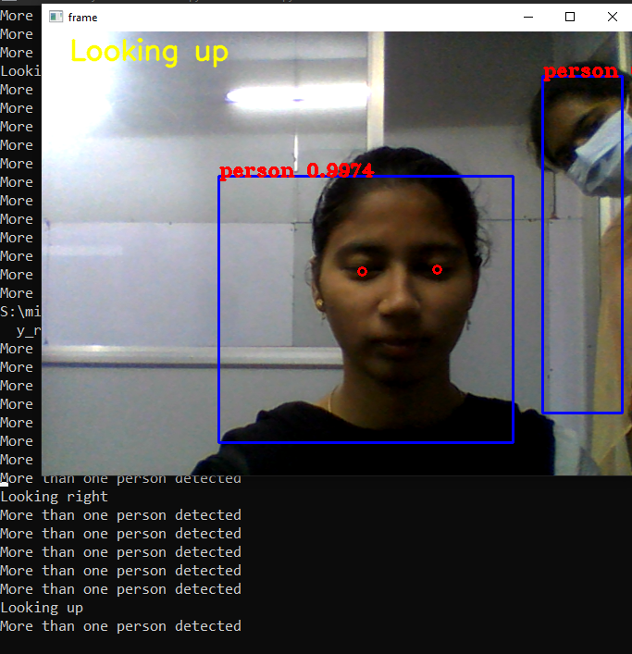
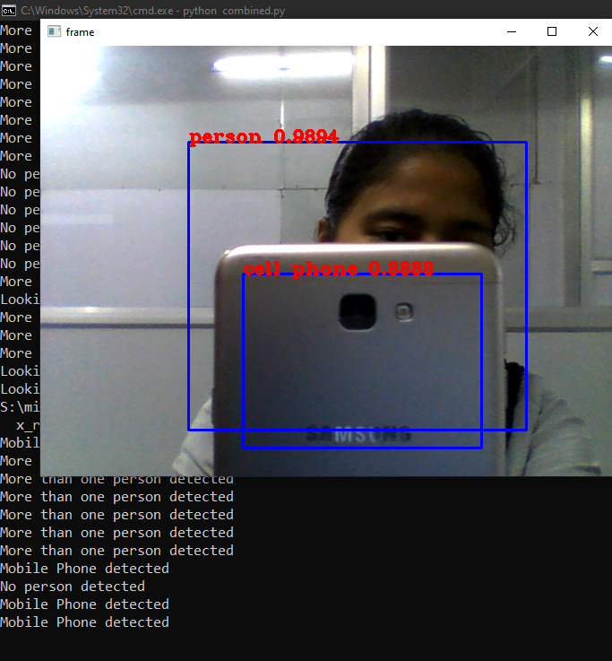
Output For Object Detection
No Person Detected
More than One Person Detected
Mobile Phone Detected

Slide 8
Thank you

